Slide 1
Group 16 Project
FIN 580
Lica Kou
Siun Park
Hoover Liu
Chi Zhang
Rishabh Kedia
Rishi Jain

Slide 2

10 years Momentum Trading Strategy
Introduction
Detailed Coding Explanation
Result
Conclusion

Slide 3
Introduction
1

Slide 4
Our project in a few words…
Momentum strategy (Our strategy: Cross-sectional and going long) Momentum investing is a system of buying stocks or other securities that have had high returns over the selected past period, and selling those that have had poor returns over the same period
Select 10 stocks each year from Dow Jones components
Verify whether portfolio returns outperform Dow Jones index returns
Cross- Sectional
Choose from a large pool of securities by emphasizing on the relative returns
Go long the securities that have outperformed their peers and go short those that have underperformed
Types
Time Series
Emphasize on a security’s own past return and use it as the benchmark
Go long the security if it has recently performed well and go short the security if it has performed poorly

Slide 5
Detailed Coding Explanation
2

Slide 6
Steps-Portfolio Design
Collect Tickers
(2010-2020)
Get Data
(Adj Close)
Compute & Rank Annualized Return
Choose Top 10 Stocks to invest for following year
Compute
Portfolio Return
Repeat from 2010 to 2019

Slide 7
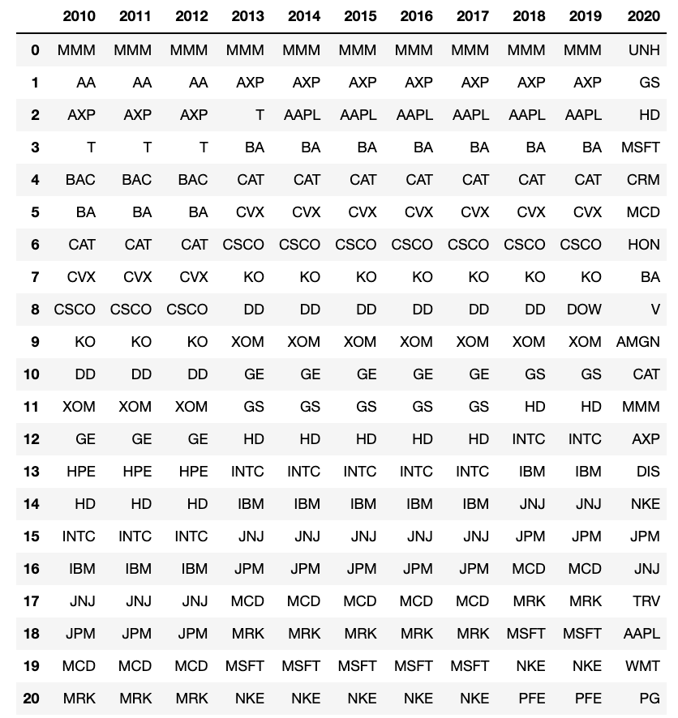
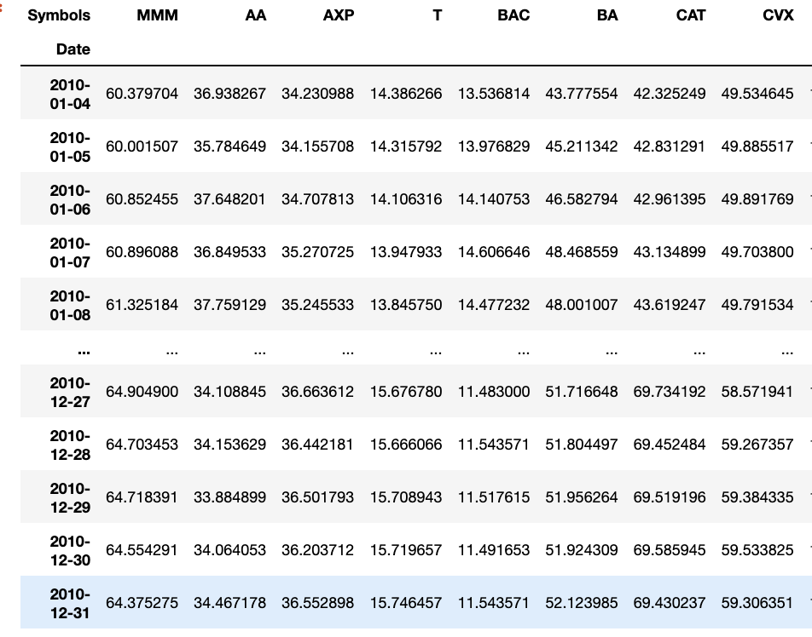
Collect Tickers and Get Data
Get tickers of Dow Jones components from 2010 to 2020
ticker=pd.read_csv('dowjones.csv’)
Get data from Yahoo Finance
df10 = pdr.get_data_yahoo(ticker.iloc[0:29,0], start='2010-01-01',end='2010-12-31')['Adj Close']

Slide 8
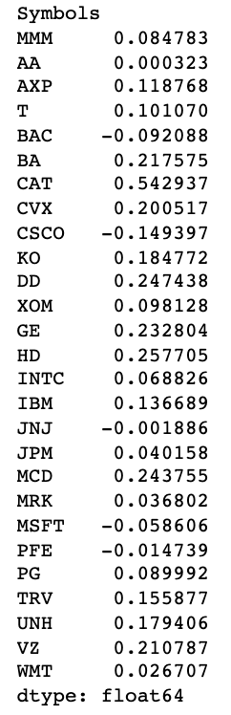
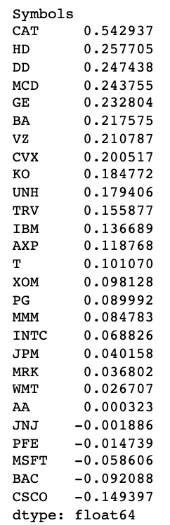
Compute and Rank Stock Returns
Compute simple returns
df10_return=df10.pct_change()
Compute average annual returns
df10_avg_annualreturn=df10_return.mean()*250
Sort annual returns in descending order
df10_avg_annualreturn.sort_values(inplace=True, ascending=False)

Slide 9
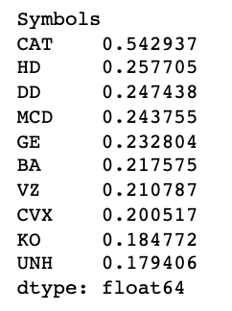
Select Top 10 Stocks and Form Portfolio
Select top 10 stocks
r10_selected=df10_avg_annualreturn[0:10]
In 2010, we select
Caterpillar Inc. (CAT)
The Home Depot, Inc. (HD)
E.I. du Pont de Nemours & Company (DD)
McDonald's Corporation (MCD)
General Electric Company (GE)
The Boeing Company(BA)
Verizon Communications Inc. (VZ)
Chevron Corporation (CVX)
The Coca-Cola Company (KO)
UnitedHealth Group Incorporated (UNH)
Invest in 2011

Slide 10
Calculate Portfolio Returns
Get tickers
r10_selected_ticker = r10_selected.index
Get data for next year
df11_selected=pdr.get_data_yahoo(r10_selected_ticker, start='2011-01-01',end='2011-12-31')['Adj Close’]
Compute returns
df11_selected_return=df11_selected.pct_change()
df11_selected_annualreturn=df11_selected_return.mean()*250
Compute portfolio returns (equally weighted)
W=[0.1, 0.1, 0.1, 0.1, 0.1,0.1,0.1,0.1,0.1,0.1]
port_11=np.dot(df11_selected_annualreturn,W)
2011 Portfolio Returns 0.16207801680239425

Slide 11
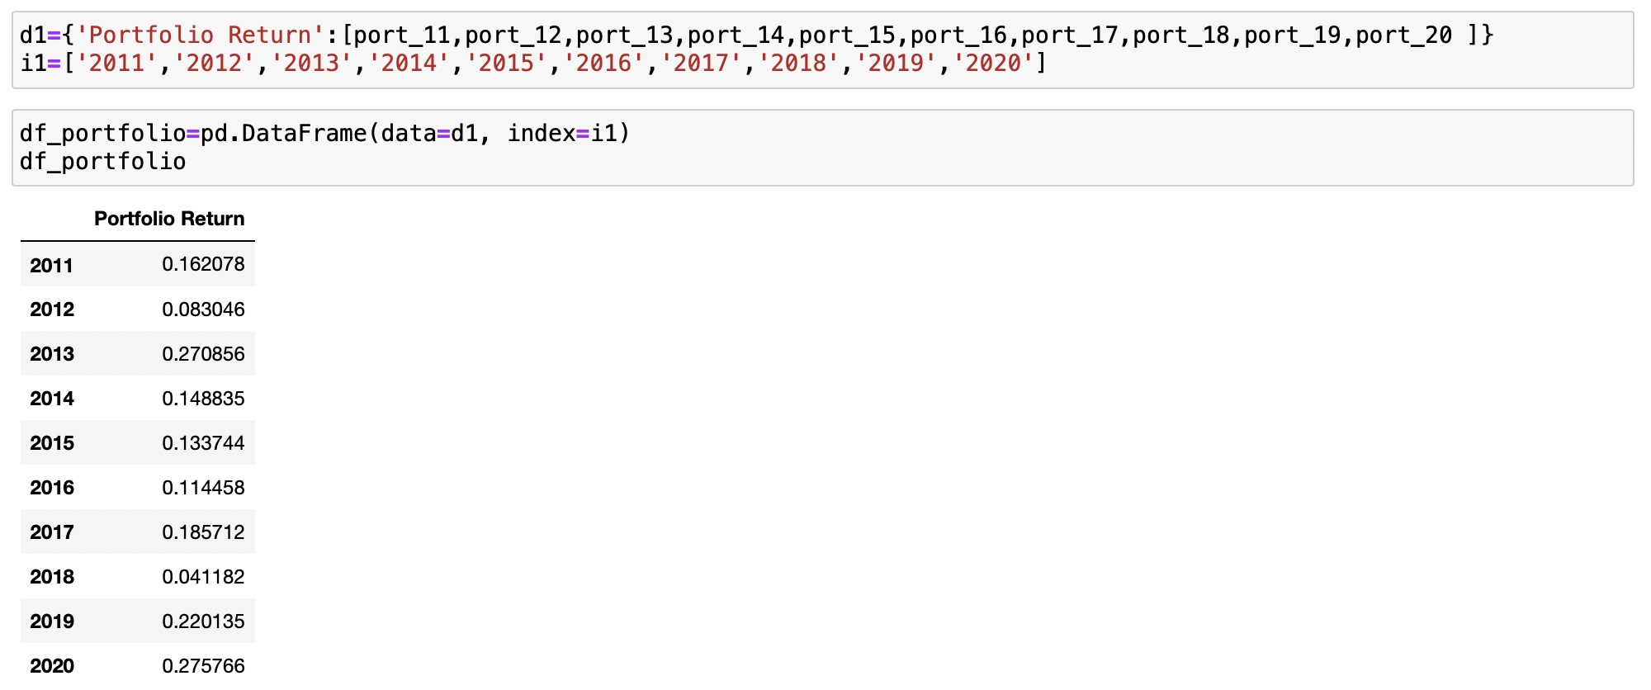
Continue for the Following Years

Slide 12
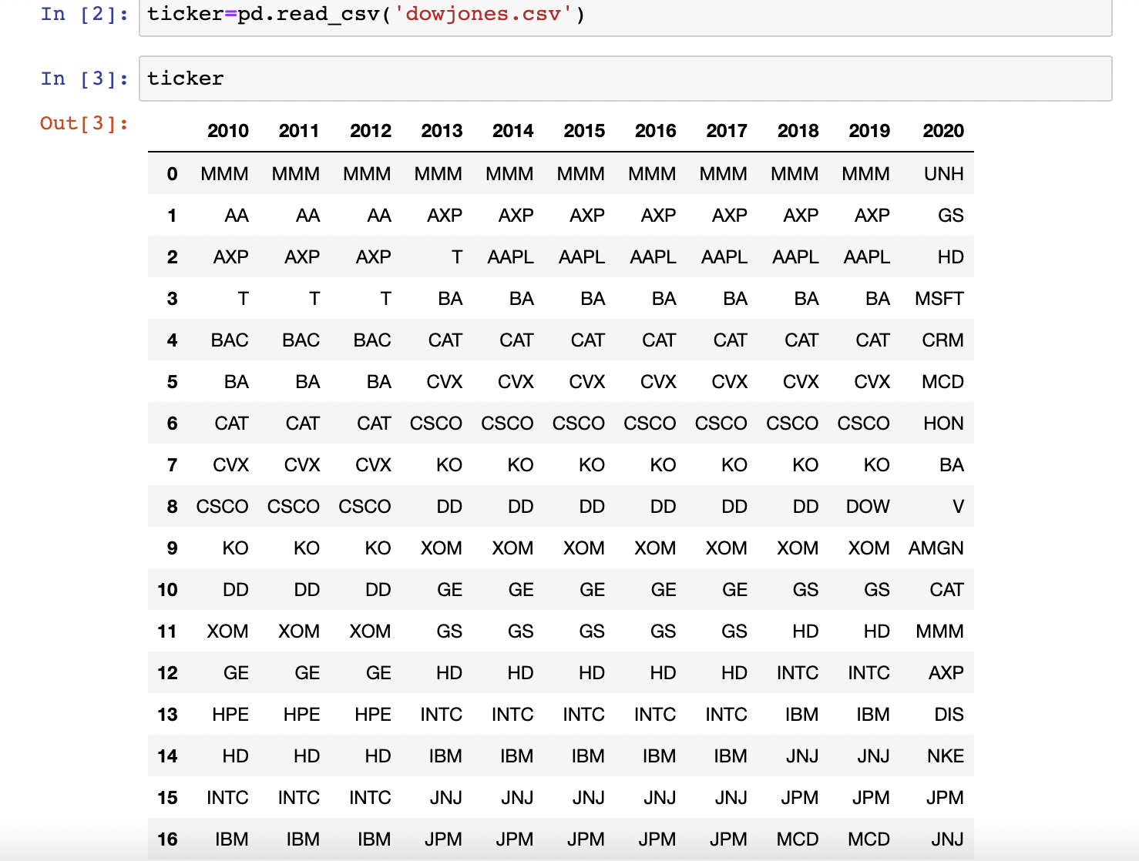
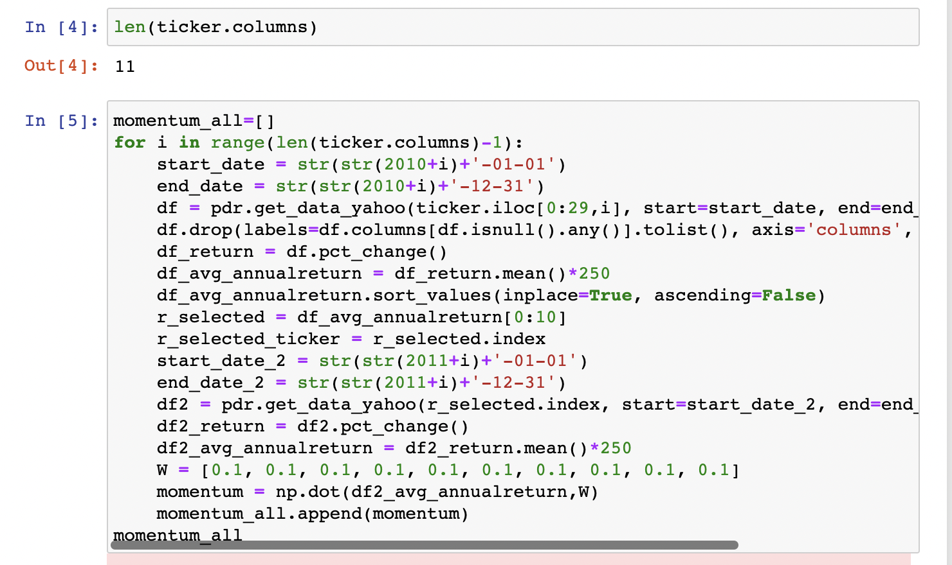
Alternative Method-For Loop

Slide 13
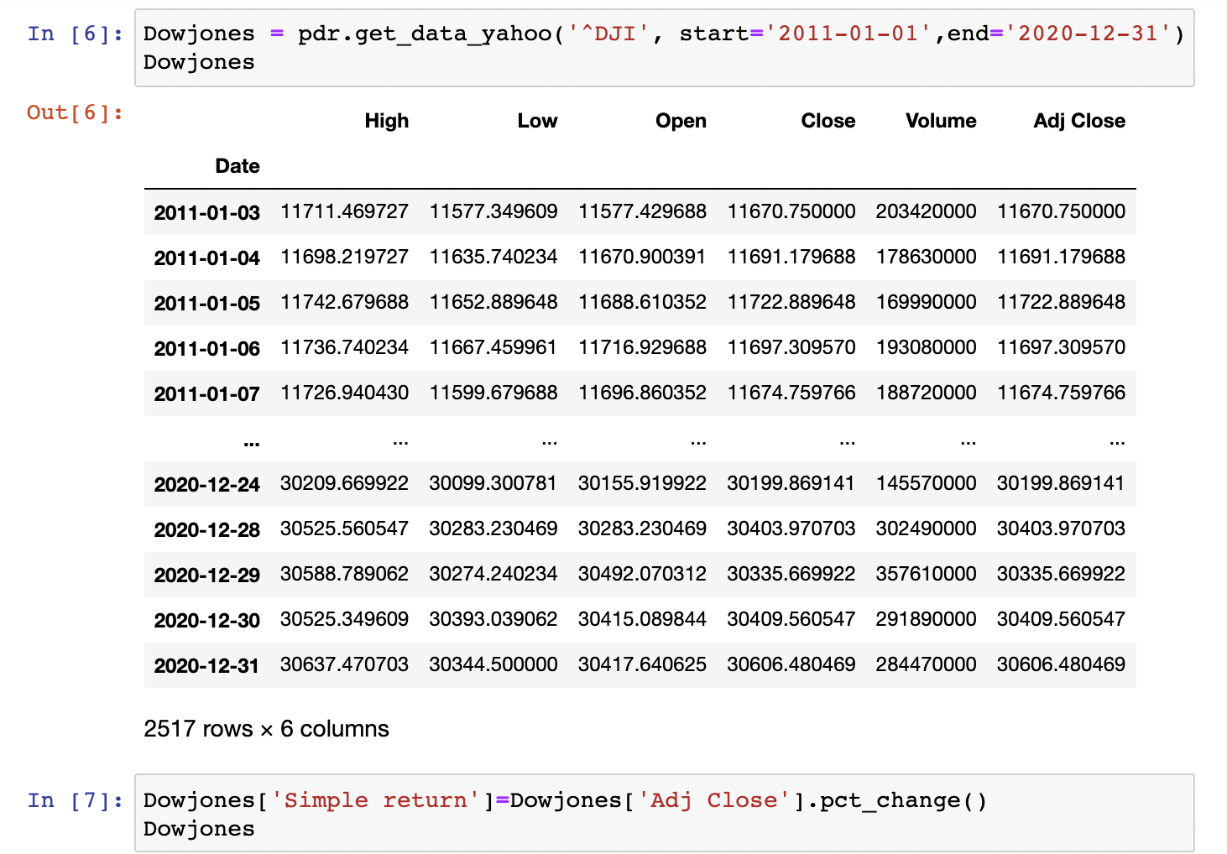
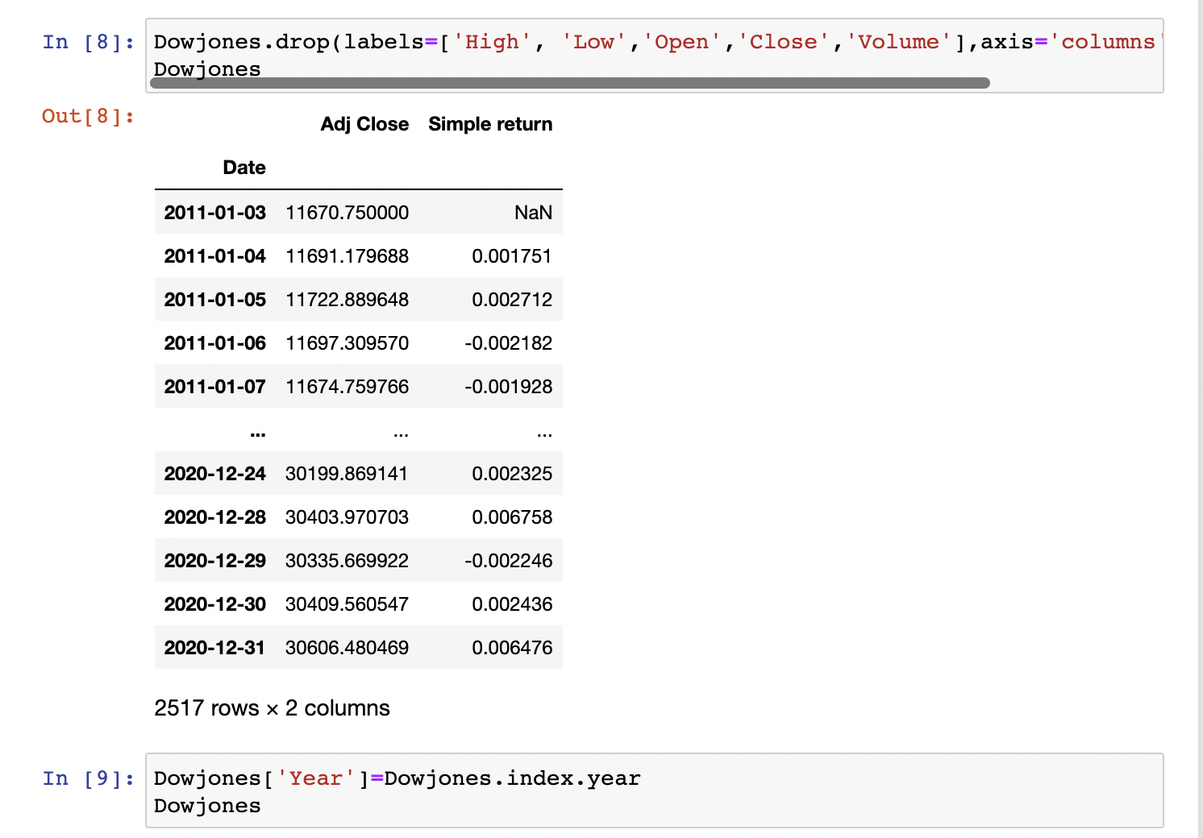
Visualize Portfolio Return

Slide 14
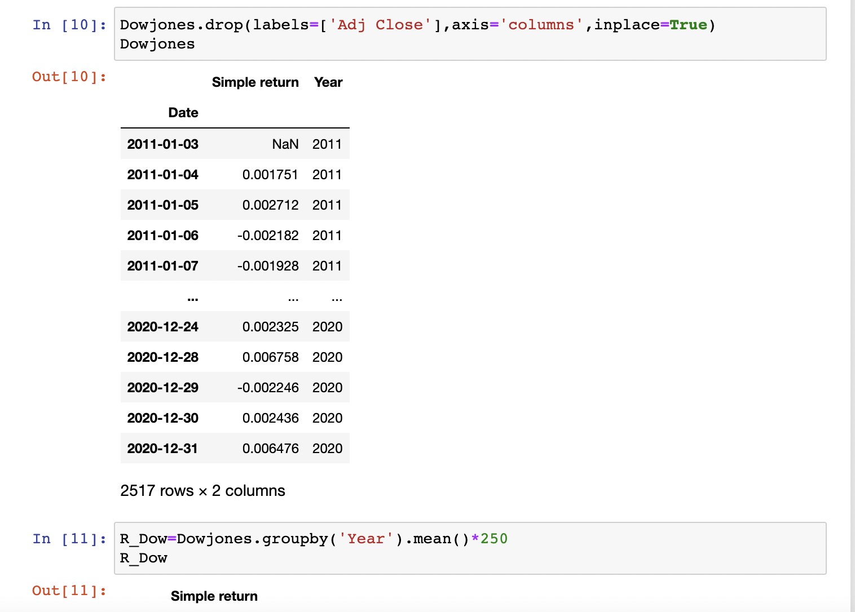
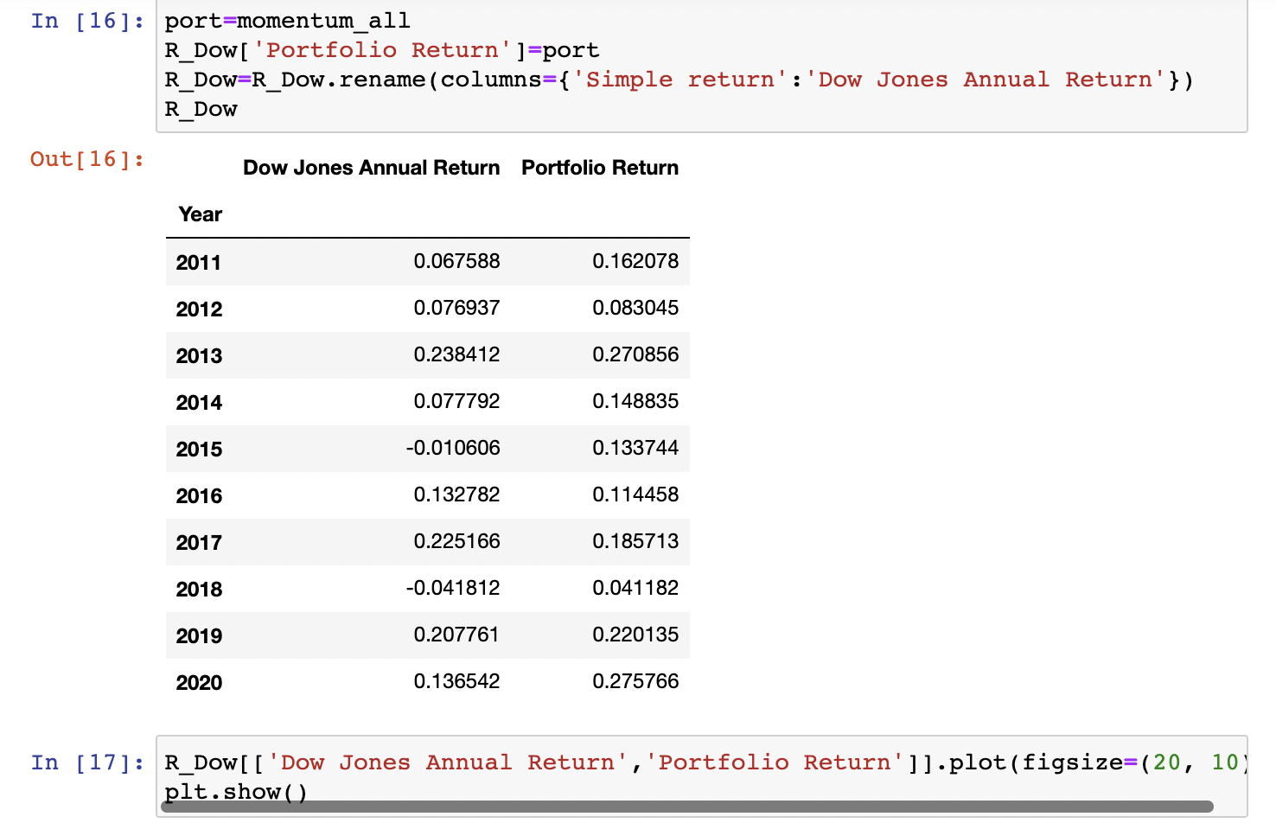
Visualize Portfolio Return

Slide 15
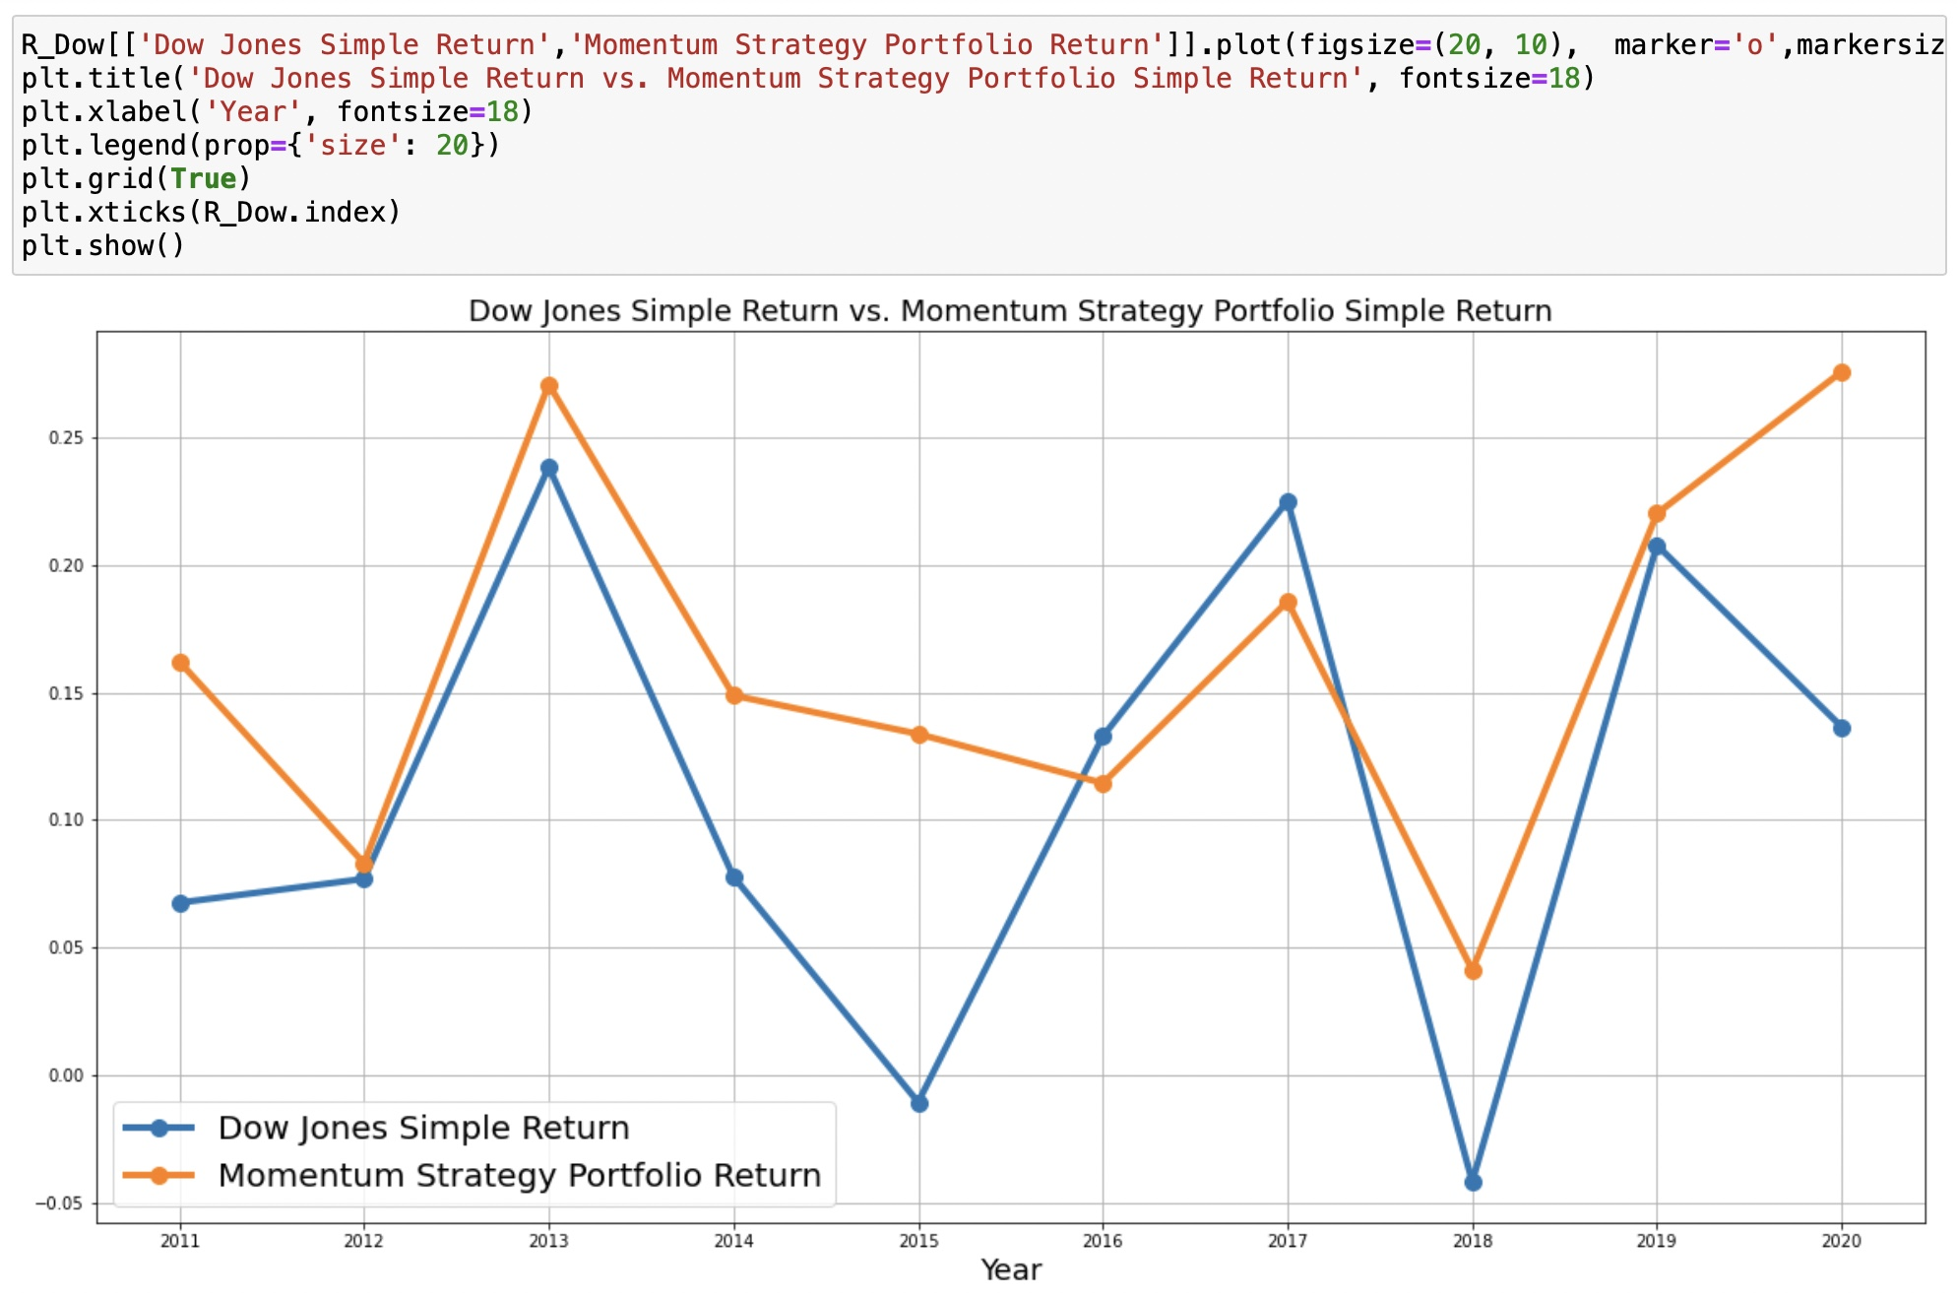
Dow Jones Simple Return vs Momentum Strategy Simple Return

Slide 16
Result
3

Slide 17
What We Observed
Overall, our portfolio performed better than the Dow Jones annual return
Our portfolio would also fluctuate with Dow Jones annual return

Slide 18
Conclusion
4

Slide 19
What We Can Do Next…
Momentum as the only strategy maybe not enough
Try to add some other determinant (e.g. book-to-market ratio…)
Or try to form the style portfolio to have more flexible trading options
 |  | Valuation
 |  | L | M | H
Capitalization | S
 | M
 | B

Slide 20
Thank you!

